Slide 1
So… What’s Your Type?
Guessing an Agent’s Type from Observed Actions
Neel Patel

Slide 2
Motivation
How tough of a grader is this new TF?
Have any of my friends been in a class with her before?
If I can estimate someone’s type, how can it help me improve my own utility?

Slide 3

Experiment Details
Simple grid environment where types = goal locations
G₁
G₂
G₂

Slide 4
Experiment Details
What the playing agent sees:
What the observing agent sees:
G₁
G₁
G₂
G₂
Given a goal, solve an MDP and move to it
Given observations of movements, guess a goal

Slide 5
Experiment Details
For each possible goal, calculate the optimal policy (solve the MDP)
What the observing agent sees:
G₁
G₂
Up = 8 (optimal)
Down = -1
Left = -1
Right = -1
For each optimal policy, calculate the likelihood of the observed history
G₂

Slide 6
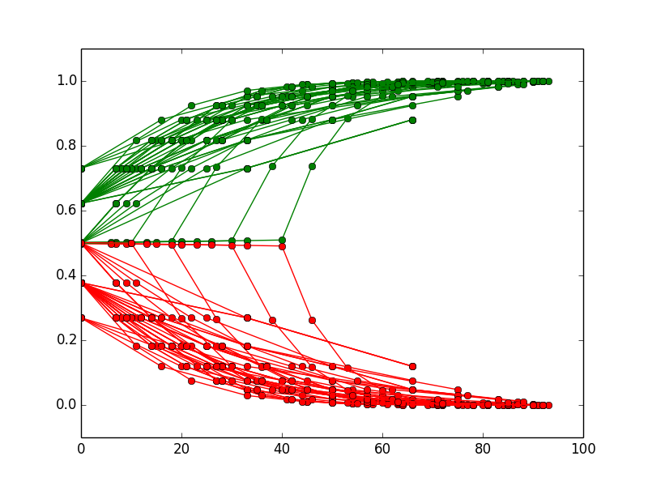
Determining Types
Fixed goals: Agent Type 1 on the upper left, Agent Type 2 on the right
10x10 grid, fixed goals

Slide 7
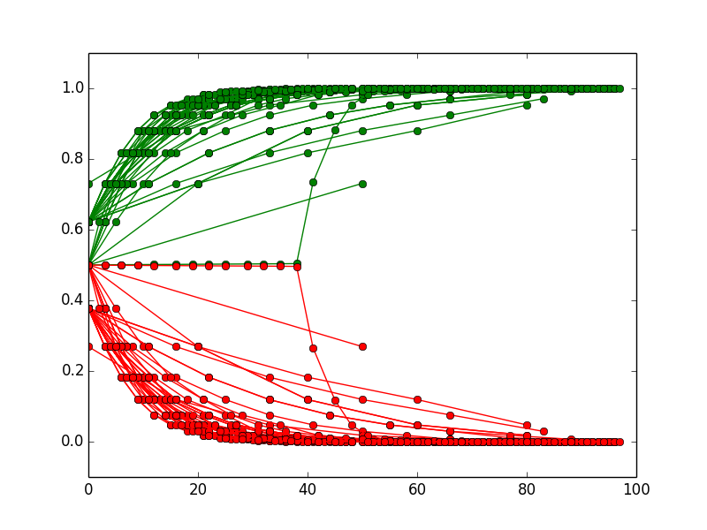
Determining Types
Fixed goals: Agent Type 1 on the upper left, Agent Type 2 on the right
10x10 grid: fixed goals
20x20 grid: fixed goals

Slide 8
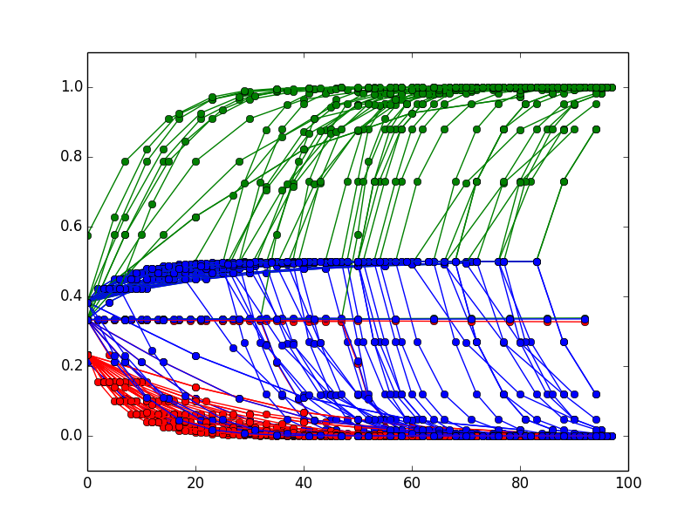
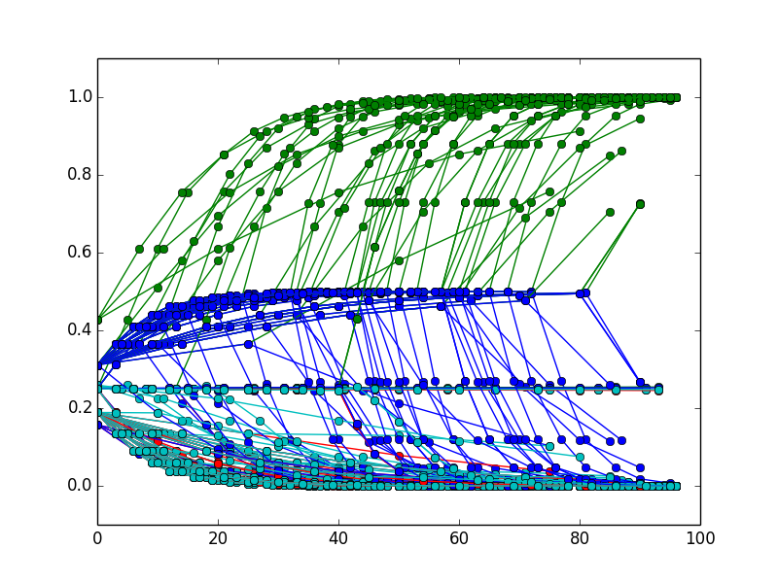
Determining Types
Fixed goals: Agent Type 1 on the upper left, Agent Type 2 on the right
20x20 grid: 2 fixed goals
20x20 grid: 3 fixed goals
20x20 grid: 4 fixed goals

Slide 9
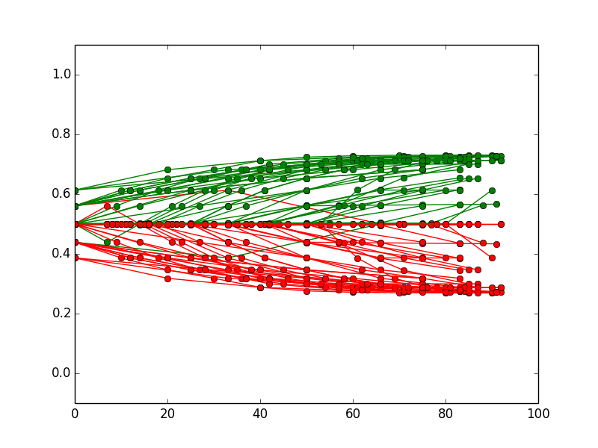
Determining Types
Goals for each type can also be chosen uniformly at random from the grid
10x10 grid: fixed goals
10x10 grid: random goals
How much can we decrease the distance between goals while maintaining performance? How ‘different’ do types have to be?

Slide 10
Multiple Observers
How can I combine my observations with yours?
What if we have different ideas of what each type of agent is, because we’ve been trained differently?
What if Observer 1 and Observer 2 are observing different things? Disjoint or not?

Slide 11
Multiple Observers
Combining information from multiple observers increases the accuracy and speed of identification
Observers who receive disjoint information benefit more than observers who have some overlapping information
Next steps - how many observers do we need for this to work?
Next steps - what’s the best way to combine information? Voting, weight by likelihood, etc

